Slide 1
Power Consumption Prediction
Presented by : Mansi Choudhary

Slide 2
Content
Introduction
Import Libraries
Import Data
Data Clean
Data Understanding
Feature Engineering
Data Visualizations
Feature Selection
Deep Learning
Machine Learning
Testing

Slide 3
1.Introduction
Power consumption prediction refers to the process of estimating future energy use by analyzing past power consumption patterns and other relevant factors, such as weather conditions, time of day, and industrial activity
Purpose:
Energy Management: Helps utility companies manage supply and demand more effectively.
Cost Reduction: Enables businesses and households to plan and reduce energy costs.
Efficiency Improvement: Assists in identifying areas where energy usage can be optimized.
Resource Planning: Helps in planning infrastructure investments and maintenance schedules.

Slide 4
1. Import Libraries
Imported basics Libraries
Pandas
Seaborn
Matplotlib
Seaborn

Slide 5
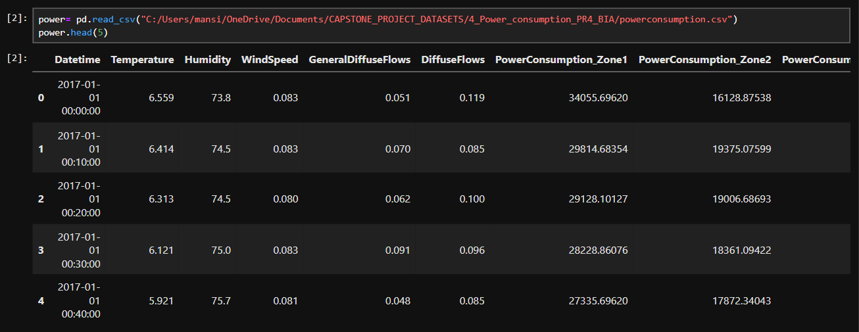
3. Import Data

Slide 6
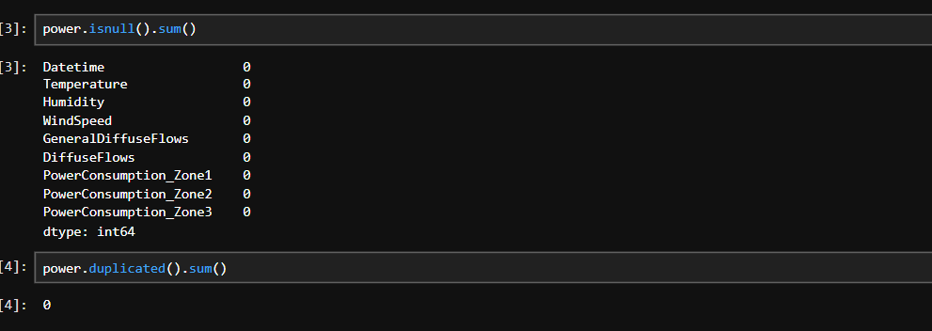
4. Data Clean
Check Null values and Duplicated Values

Slide 7
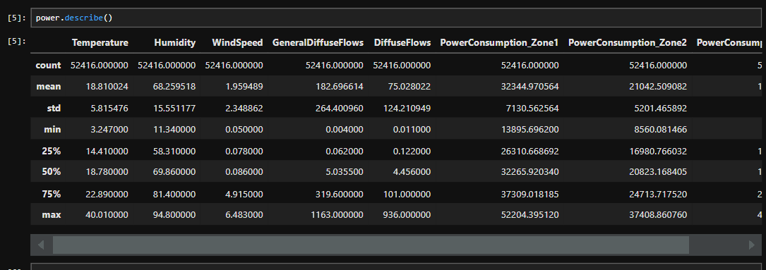
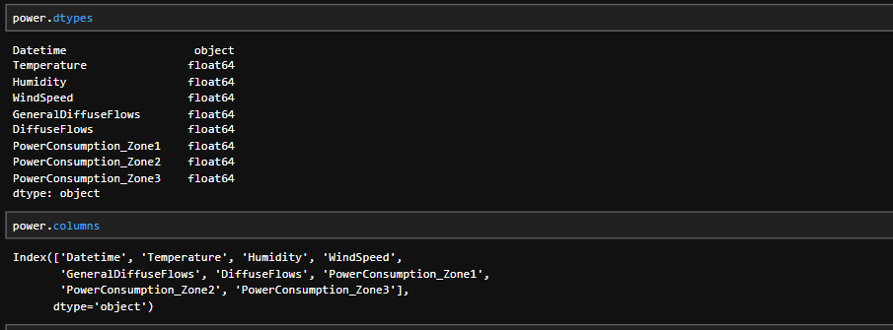
5. Data Understanding
Describe all numerical Columns
Check Data types and columns name

Slide 8
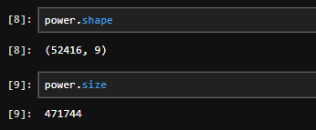
5. Data Understanding
Check Shape & Size
-for more info…List location or contact for specification (or other related documents)

Slide 9
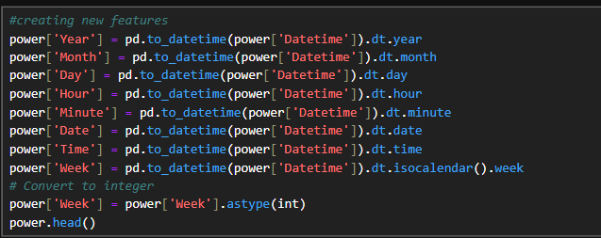
6. Feature Engineering
Created new Features:

Slide 10
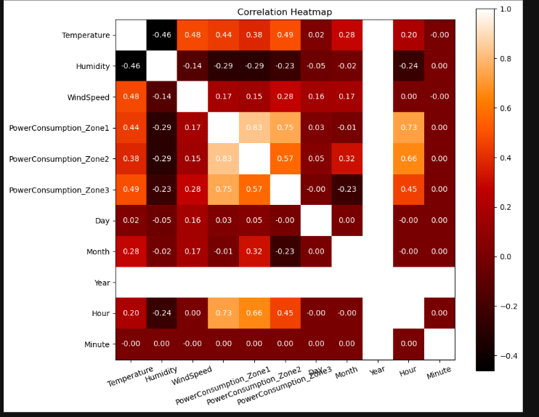
7. Data Visualizations
Correlation matrix
W.R.T Zone 3 correlation is good with Temperature ,Hours

Slide 11
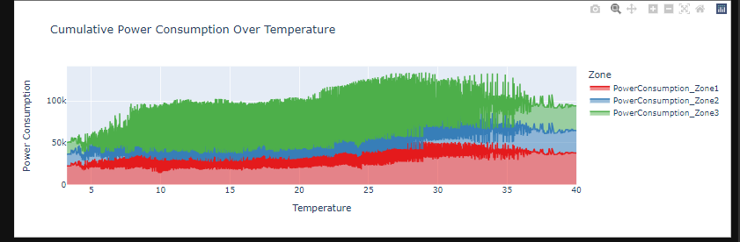
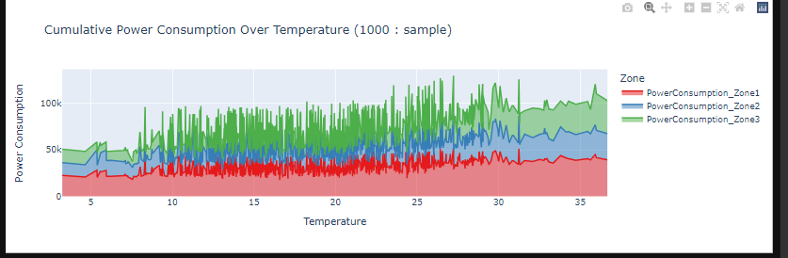
7. Data Visualizations

Slide 12
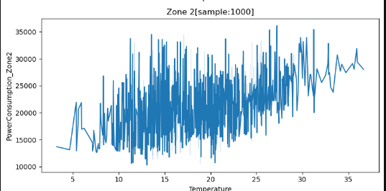
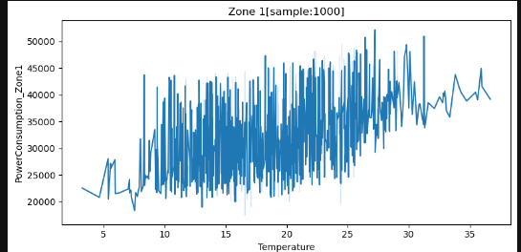
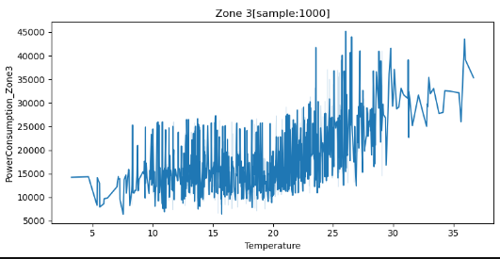
7. Data Visualizations

Slide 13
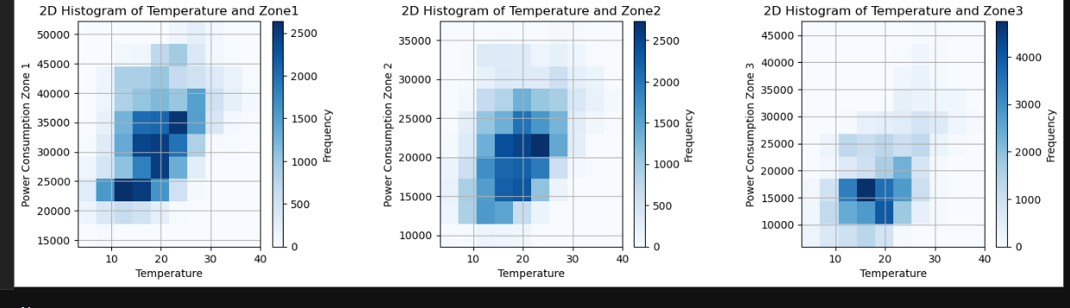
7. Data Visualizations
As temperature increasing Power Consumption also increases
With comparison to Power Consumption zones, Zone 3 has the highest frequency with respect to temperature

Slide 14
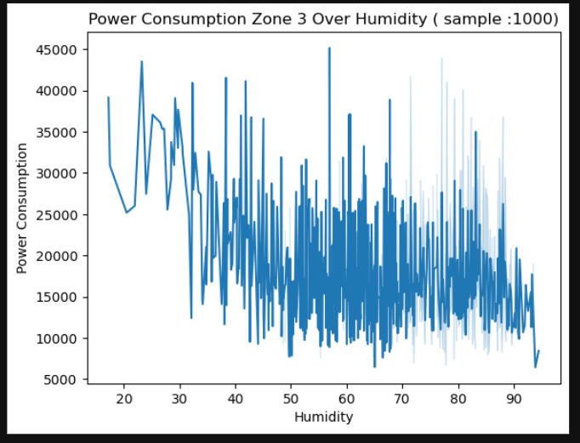
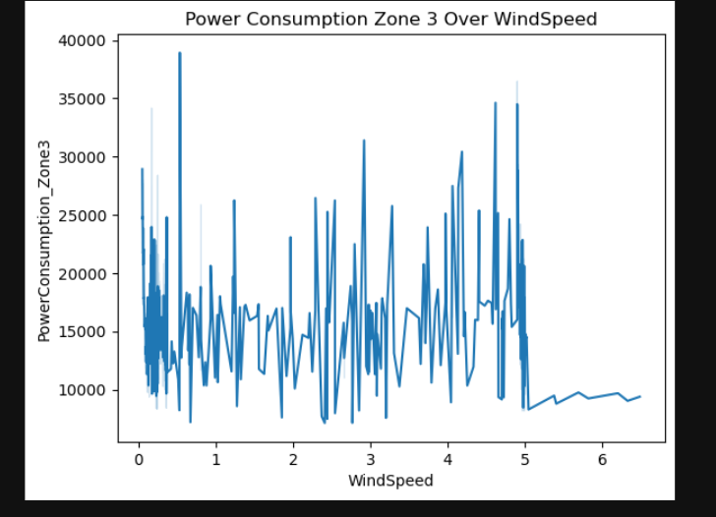
7. Data Visualizations
There no such relation, but when windspeed is more sometime consumption is less
Humidity increases Power Consumption decrease

Slide 15
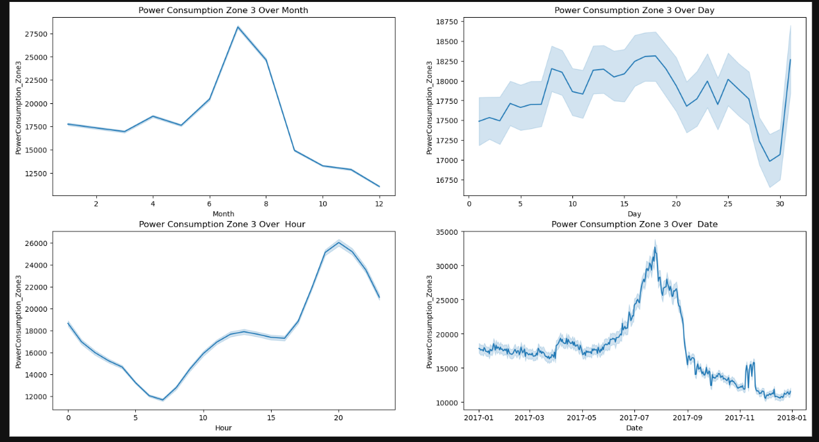
7. Data Visualizations
Power Consumption Increases from month 6 - 8, highest consumption is highest in the month of 7
2) Days between 5 - 21 power consumption rate is probably highest
3) After 6-7 power consumption is less , and after 17 it increased
(Power consumption decreases during the daytime, particularly from 6 AM to 7 PM. This reduction is likely because people are away at work or school , leading to fewer household appliances being used. .Power consumption increases significantly after 5 PM and remains high during the night. This pattern can be attributed to the use of appliances such as air conditioners, fans, and lights, as people return home and engage in various activities)

Slide 16
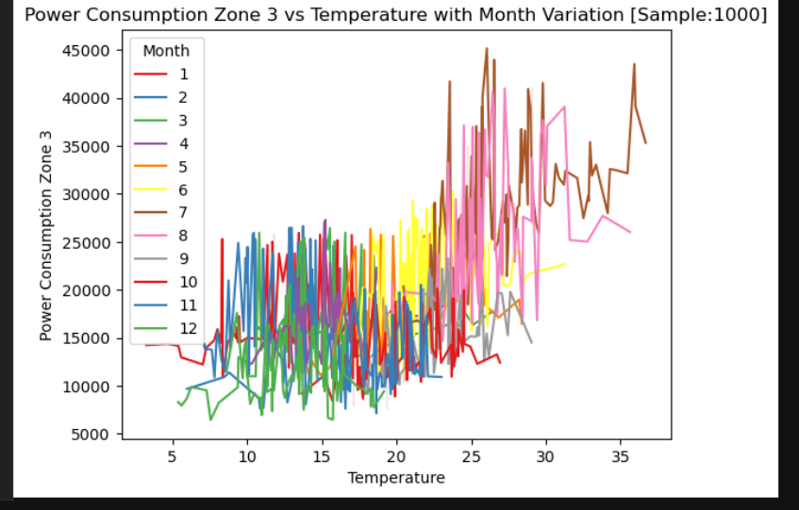
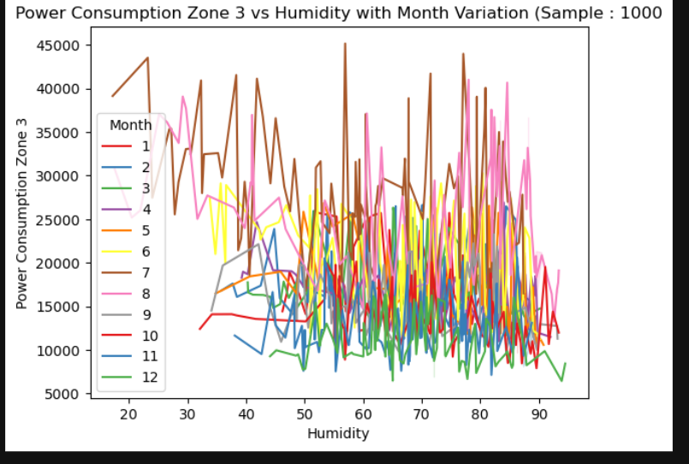
7. Data Visualizations
Humidity is more present in the month of 7 ,8 this could be also reason to increases the power consumption
In the month of 7 Temperature is increased due to which power consumption also increased

Slide 17
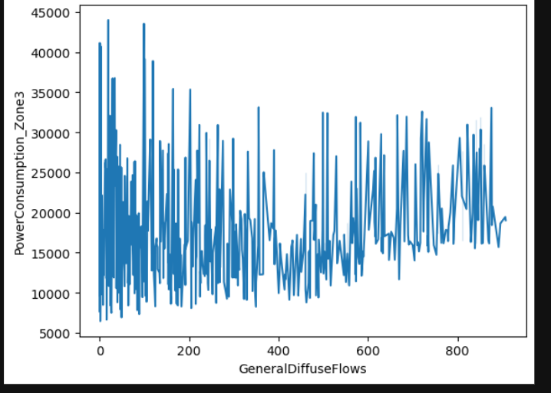
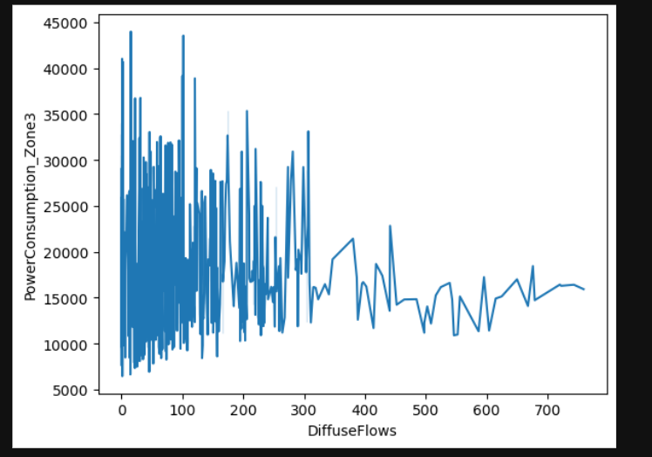
7. Data Visualizations
Power consumption is less when Diffuse Flows is more
Power consumption is less in value's between 400 -600
Power consumption is less when General Diffuse Flows is more
Power consumption is less in value's between 200 - 550

Slide 18
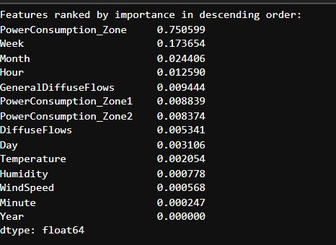
8. Feature Selection
Best Features:

Slide 19
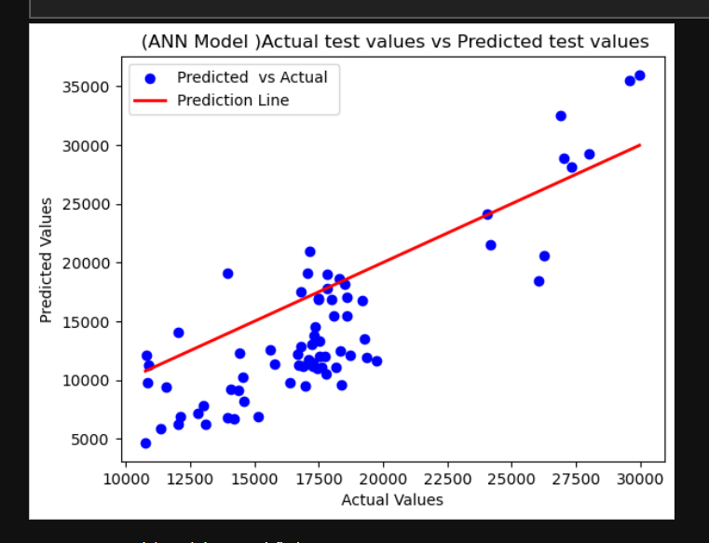
9. Deep Learning
Performed 2 models:
1.ANN model
Model not performed
well

Slide 20
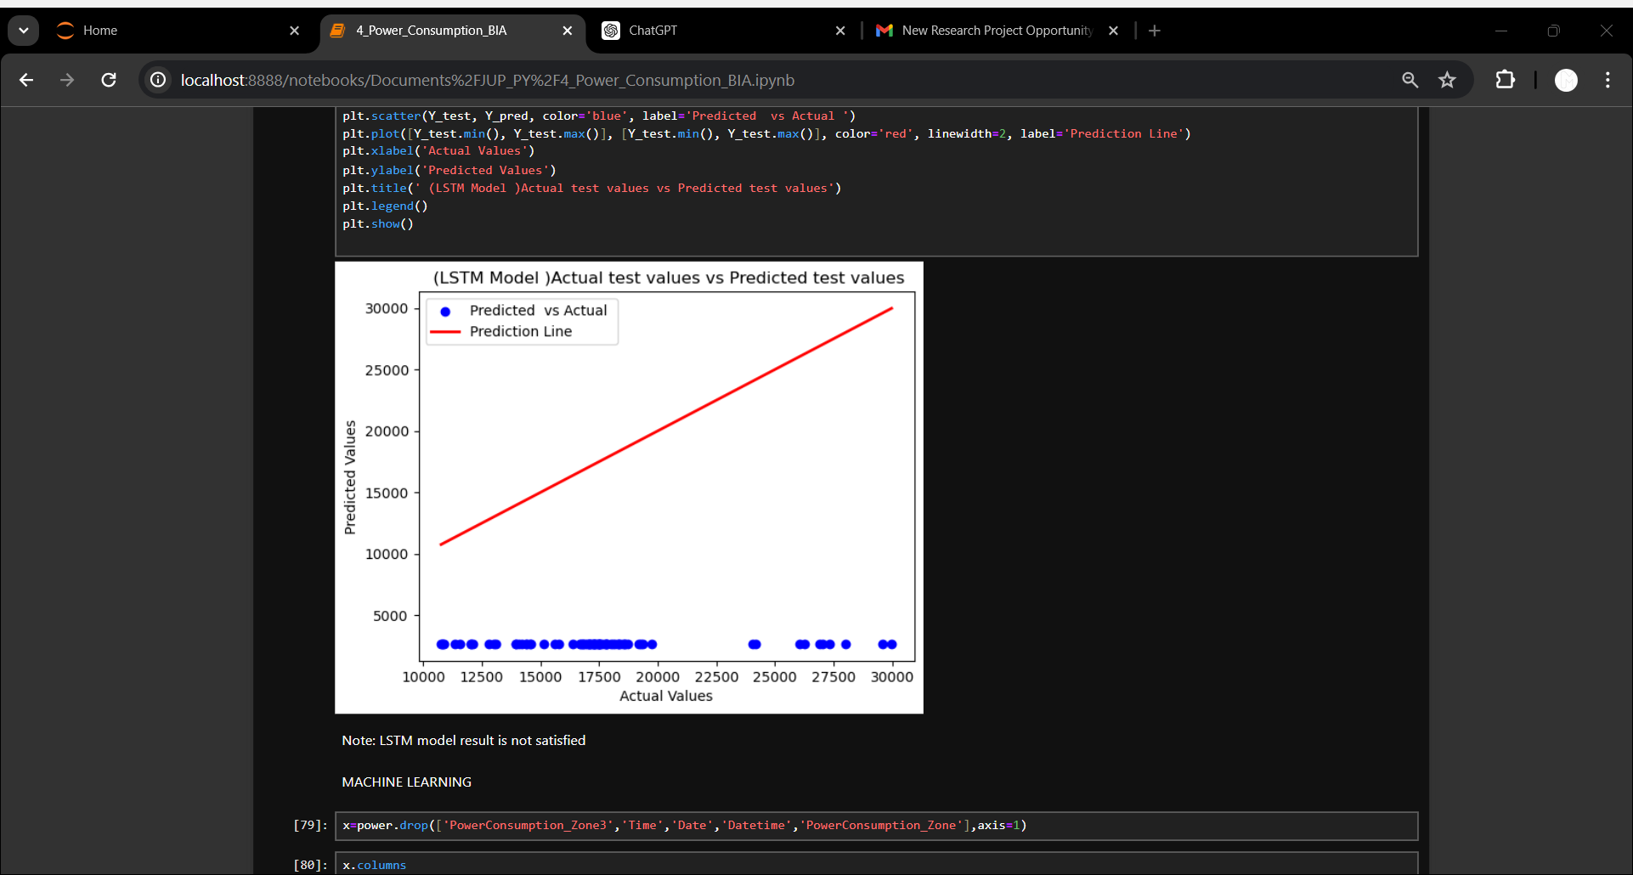
9. Deep Learning
2. LSTM Model
Model not performed
well

Slide 21
10. Machine Learning
Model used:
Linear Regression
Decision Tree
Random Forest
SVR
K Neighbors
XG Boost

Slide 22
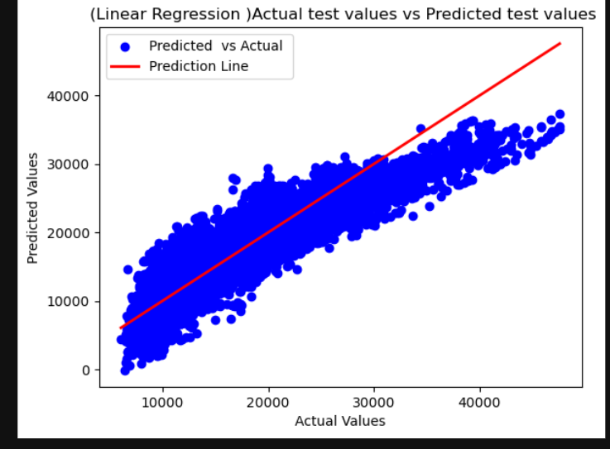
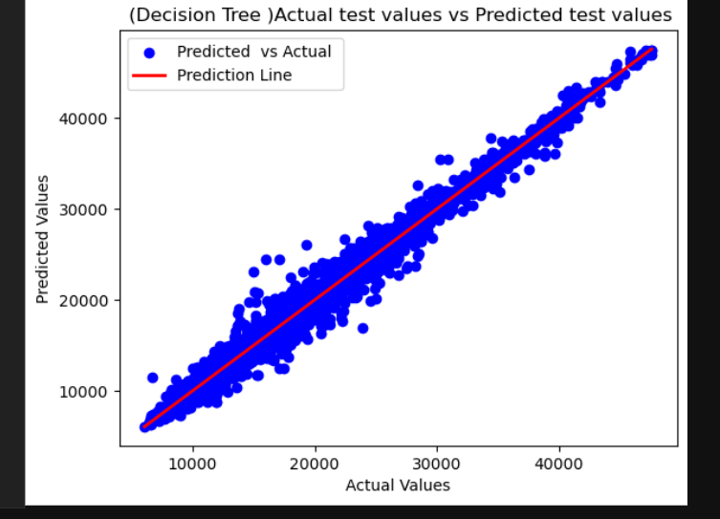
10. Machine Learning

Slide 23
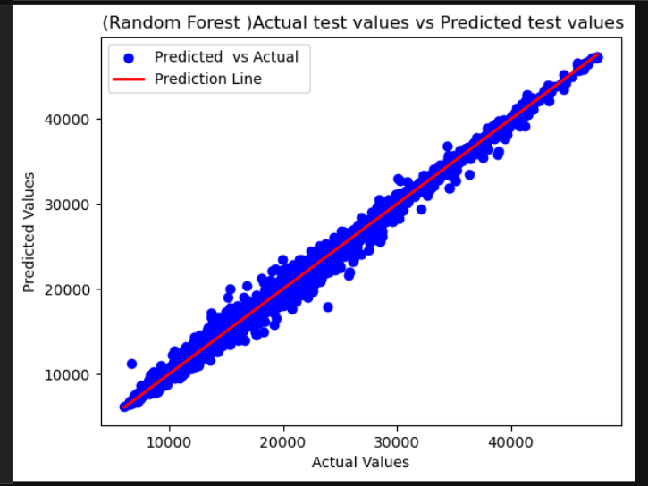
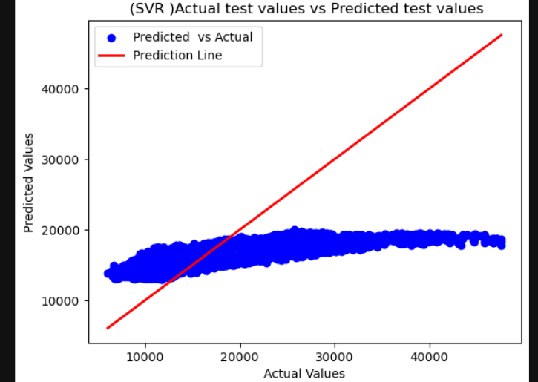
10. Machine Learning

Slide 24
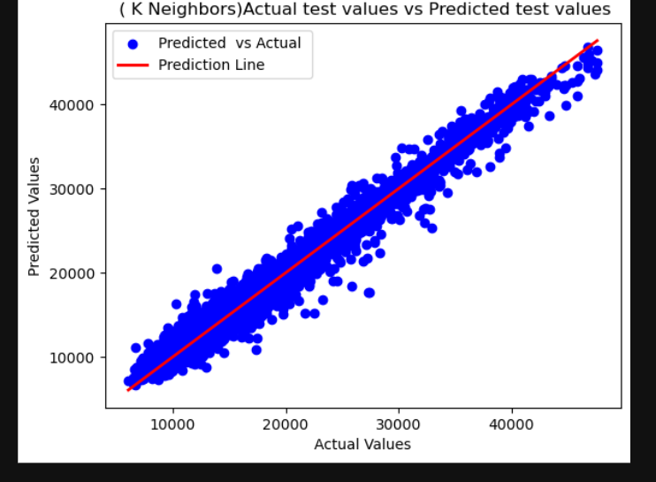
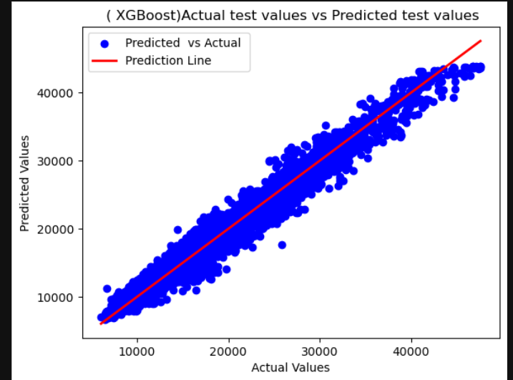
10. Machine Learning

Slide 25
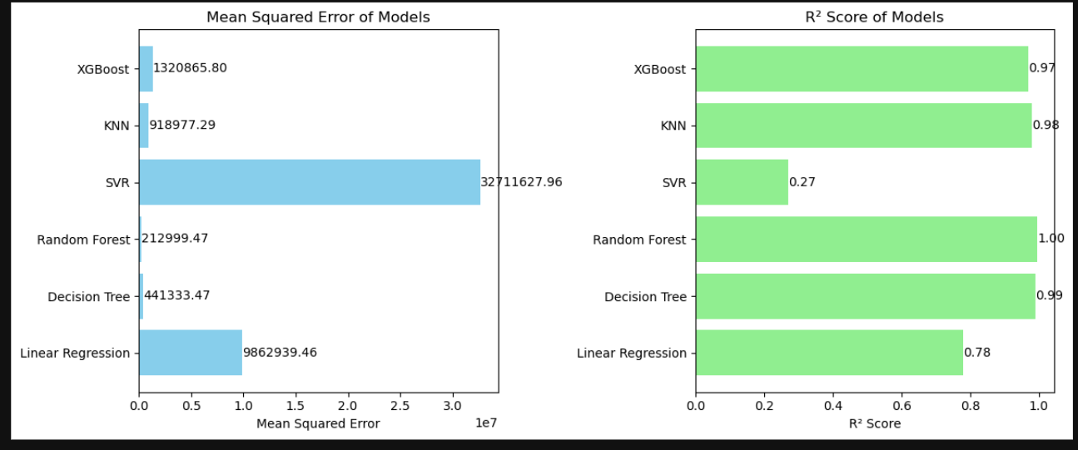
10. Machine Learning
Model Comparison
1)Although some model giving 100%, not using because model should not give 100% result
2)Best model selected is Decision Tree Regressor (Reason - R2 score is good, as well as MSE is less)

Slide 26
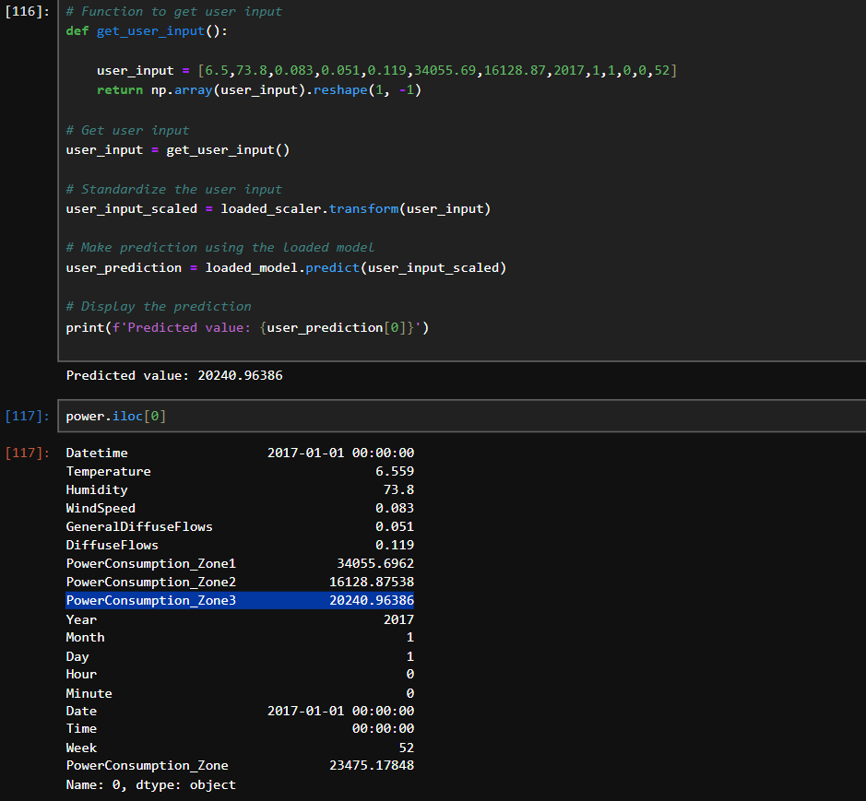
11. Testing
Model performed very well

Slide 27
THANK YOU

